Slide 1

Attitudes Towards Terror
Taegun Harshbarger & Swasti Mishra

Slide 2
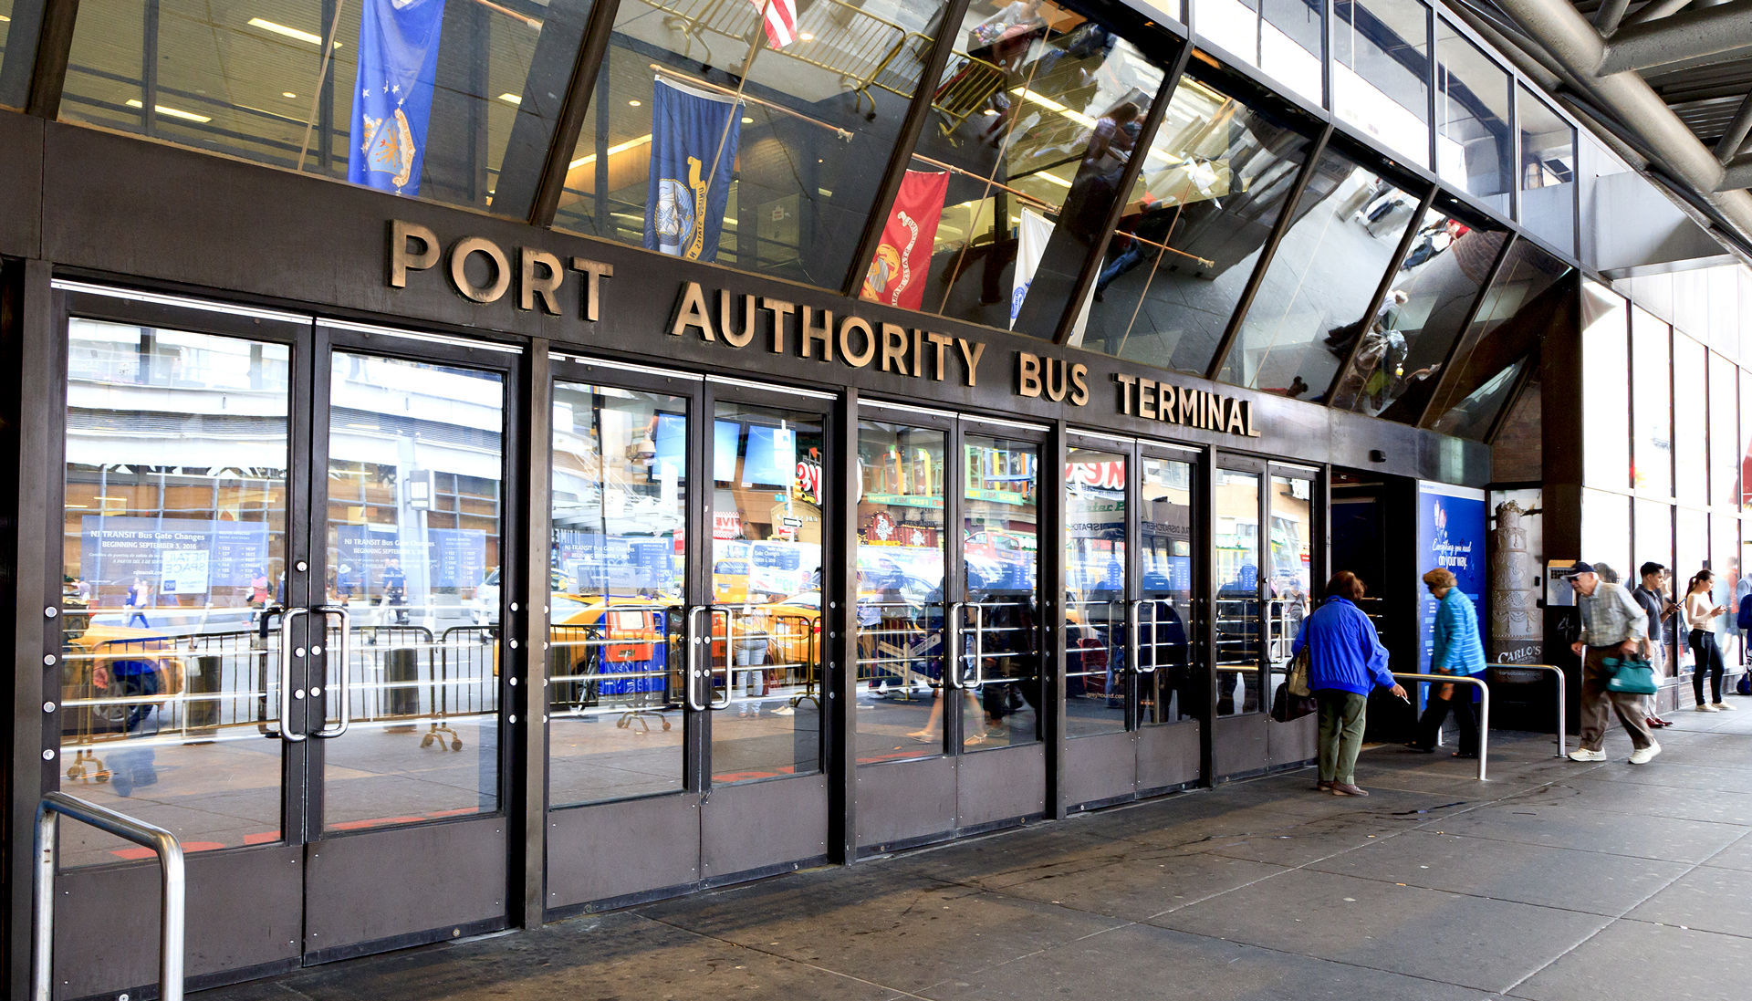
Historical Context
Older generations witnessed 9/11 and the subsequent war on terror
Younger generations grew up with the US perpetually stationed and at war in the Middle East
Apathy towards 9/11 isn’t defined by political leaning, but instead by time elapsed.
Our project studies this in two ways
Polling
Sentiment Analysis
Notes:
Taegun - Based on our research it seems that apathy towards 9/11 is not defined by political leaning but instead by time elapsed. Over time, the tragedy has lost weight, and the subsequent aftermath has permeated the country. Younger generations did not see the event, but instead grew up with wars in the middle east. Older generations remember the tragedy very well and it still weighs on their mind.

Slide 3
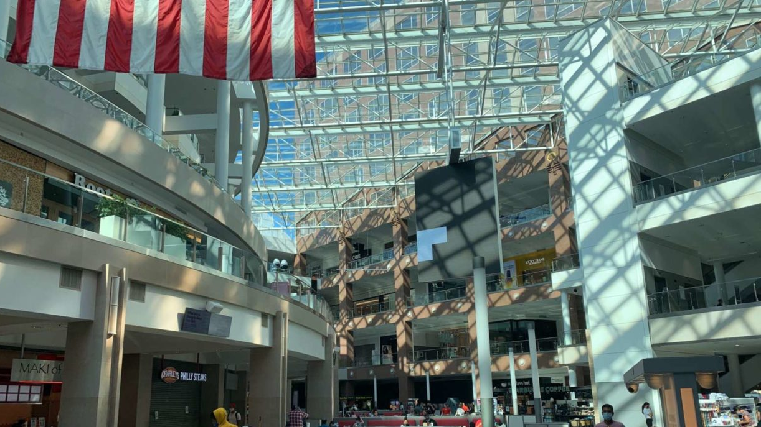
Polling Method
Analyzed polling data from the New York Times and Gallup
Data was taken from surveys with 30+ questions and answers
Both The NYT and Gallup polls used the same questions, but The NYT skipped years
The polling spanned from the days following 9/11 in 2001 to 2021
Notes:
Taegun - We analyzed polling data from the NYT and Gallup. These surveys contained 30+ questions and answers, and we chose the questions that were the most relevant to our study.

Slide 4
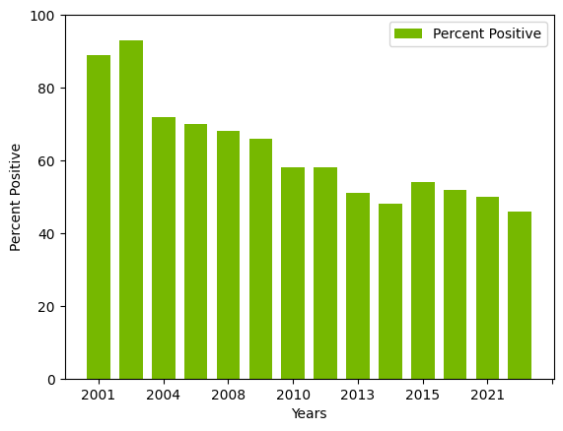
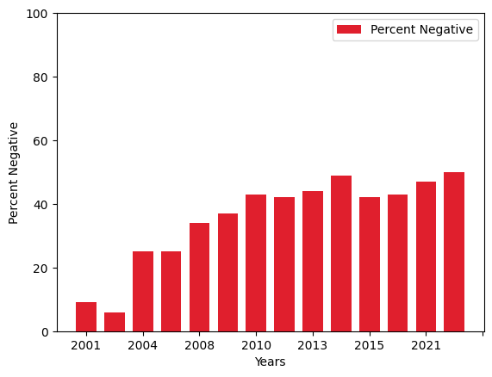
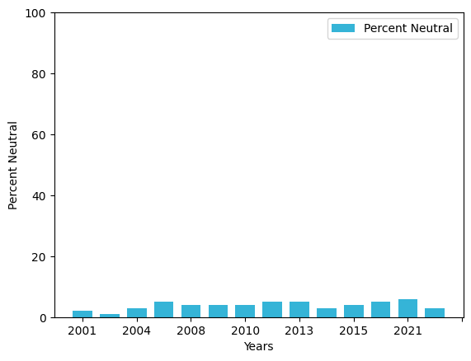
Polling Graphs
Thinking now about U.S. military action in Afghanistan that began in October 2001,
do you think the United States made a mistake in sending military forces to Afghanistan, or not?
Notes:
Taegun As the war on terror progresses the positive sentiment goes down and negative sentiment goes up. Neutral sentiment has a negligible change.
Rotated from Afghanistan to Iraq.
These trendlines show that while the war on terror progressed sentiment about the actions that the US took became more negative.

Slide 5
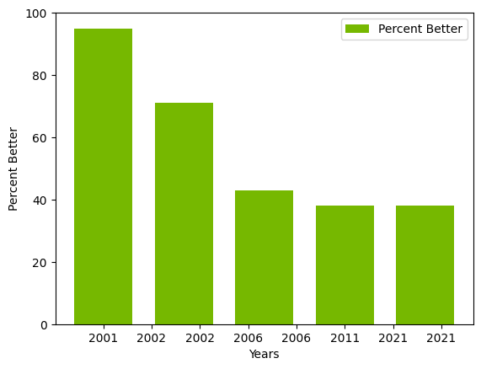
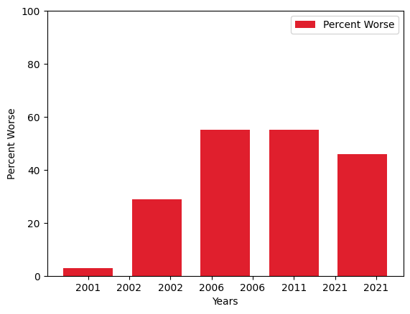
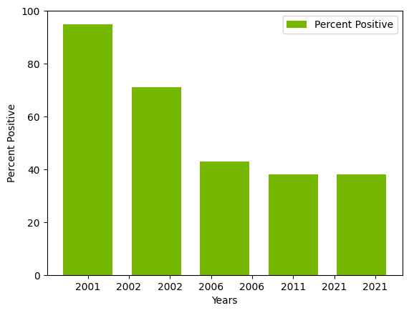
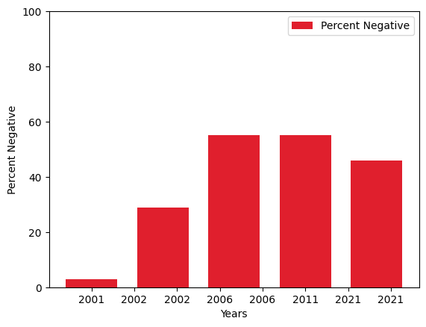
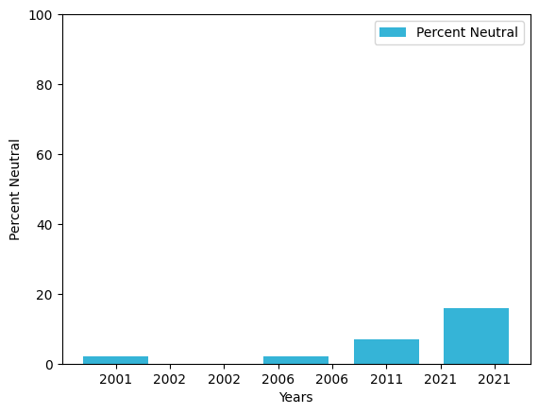
Polling Graphs
Do you think the events of September 11th, 2001 have changed this country
in a lasting way, or not? (IF YES) Is it a change for the better or a change for the worse?
2001
2002
2006
2011
2021
2001
2002
2006
2011
2021
2001
2002
2006
2011
2021
Notes:
Taegun Positive sentiment about the change our country went through after 911 goes down from 96% in 2001 to 40% in 201 and From 2011 to 2021 it plateaus. Negative sentiment goes up until 2006 and then plateaus coming down in 2021. Interestingly, neutral sentiment increases overtime. This shows that while respondents did feel that the

Slide 6

Sentiment Analysis Method
Conducted a sentiment analysis on three comparable articles from the NYT over a span of 20 years
Used Python’s VADER model from the NLTK library, which divides sentiment into positive, negative, neutral, and compound.
Words are scored from -4 to +4
Neutral words and phrases are closer to 0
"Compound" is the sum normalized between -1 for the most extreme negative and +1 for the most extreme positive
Notes:
Discuss how NLTK can even handle booster words, like “really” or “exemplary” when placed before a negative or phrases like “It really isn’t that bad” when negatives imply a positive.

Slide 7
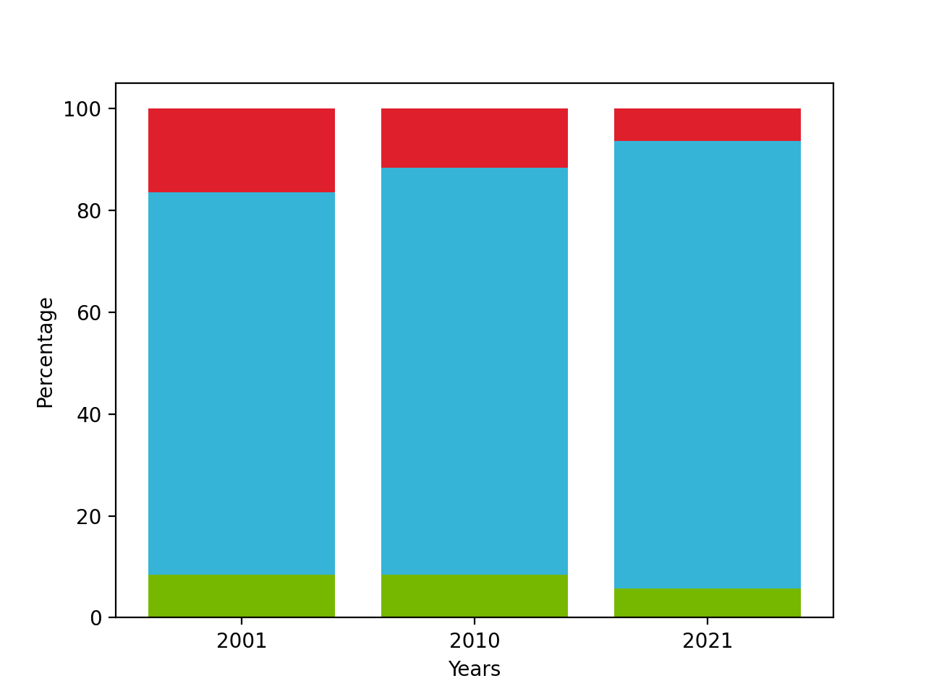
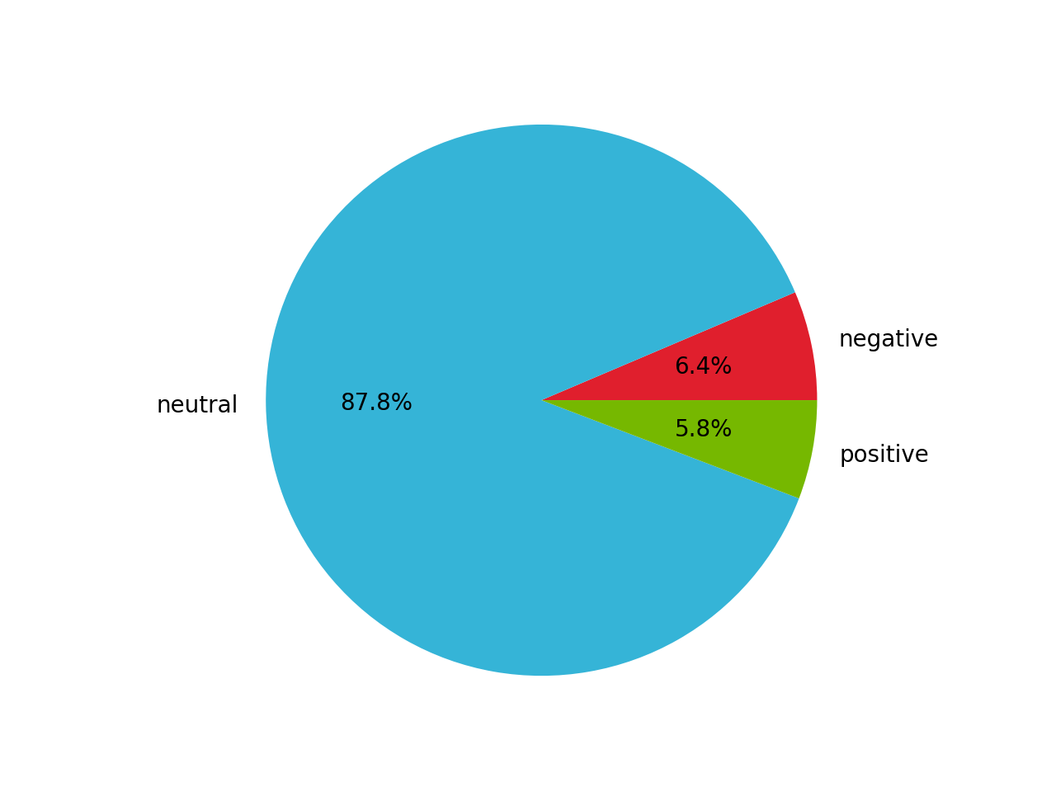
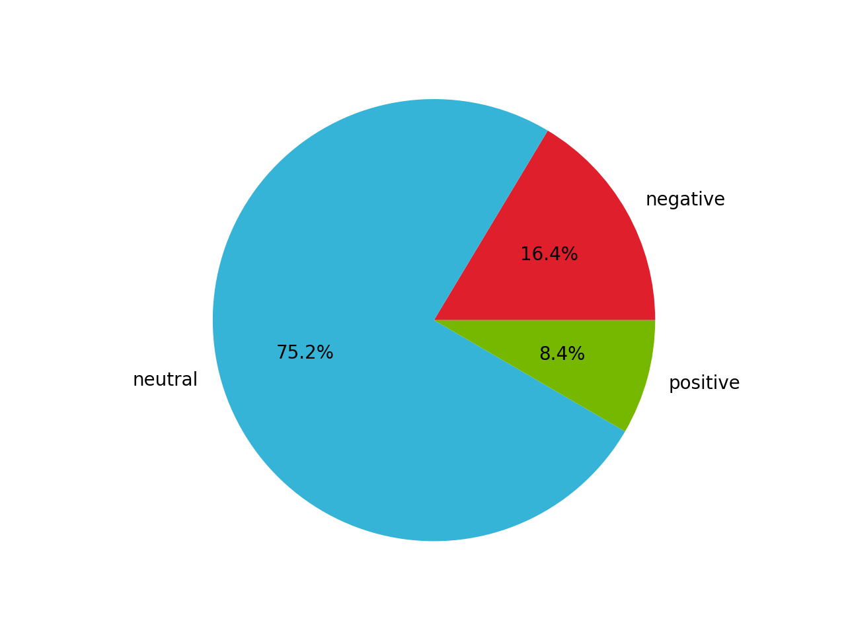
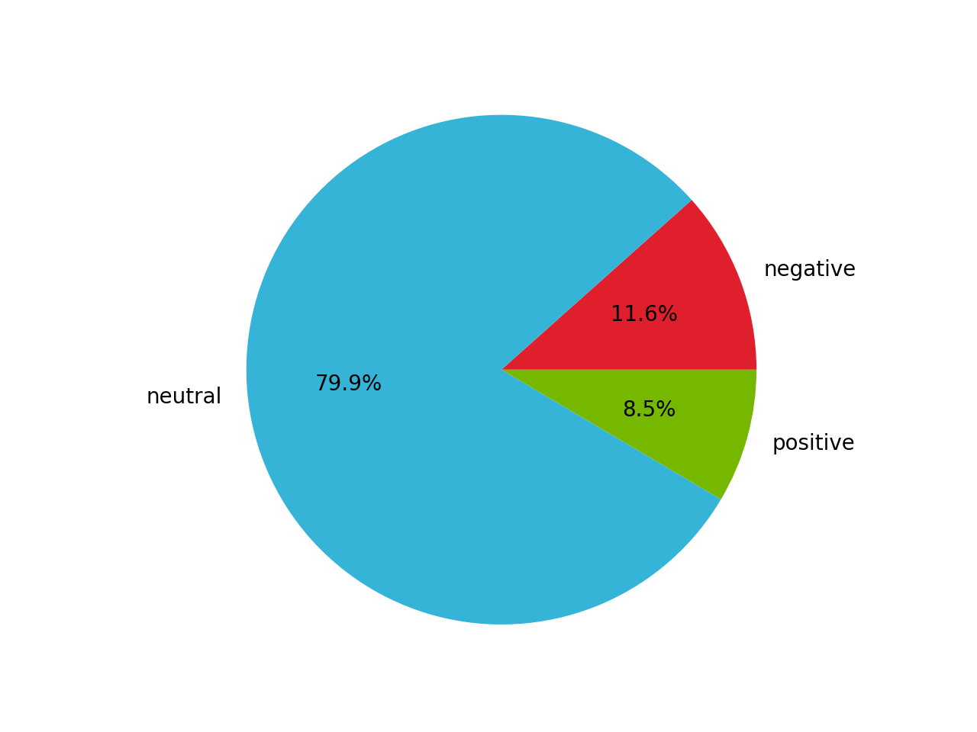
Sentiment Analysis Graphs
NYT Sentiment Shift
2001
2010
2021

Slide 8
Sentiment Analysis Graphs
NYT Sentiment Shift
Negative Sentiment
Neutral Sentiment
Positive Sentiment

Slide 9
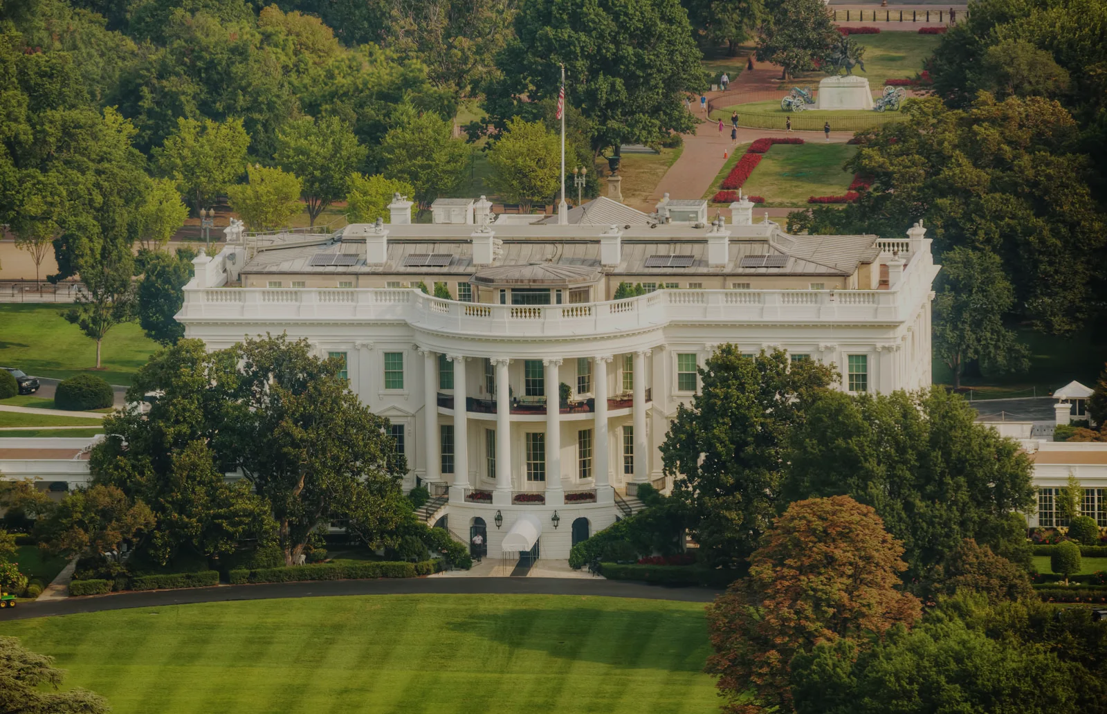
Analysis
Sentiment Analysis:
Some variance in positive versus negative attitudes, but most significantly, increase in neutrality
Perhaps due to less requirements for vivid language with the development of the internet?
Polling Analysis:
The data collected does not show an increase in negative sentiment around 9/11.
It is mostly a decrease in positive sentiment. The negativity shown is around the aftermath.
The polling data also shows that neutral sentiment increases overtime.
Notes:
[Taegun: Discuss how your poll results don’t demonstrate an increase in negative sentiment, just a decrease in positive sentiment. Use stats language, i.e., cannot accept or reject the null hypothesis, because that will support our point about apathy rather than a positive or negative)
[Taegun: Also briefly maybe what you would do with this research going forward?]

Slide 10
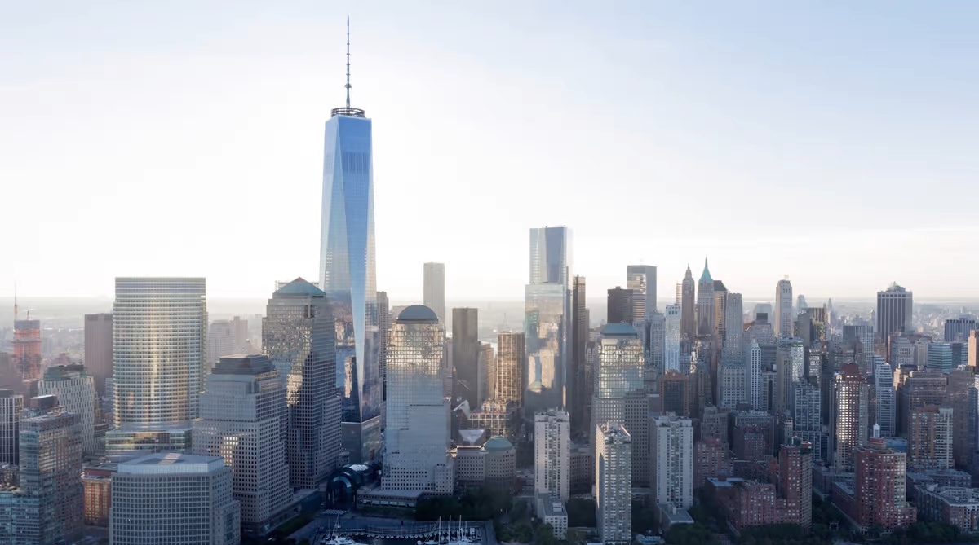
Questions?
Notes:
Beauty

Slide 11


